Slide 1
Introduction to Information Visualization
by Prof. Jeff Saltz

Slide 2
Agenda
Example
Introduction to Information Visualization
Concepts in Visualization
Principles of Visualization
Visualization in R

Slide 3
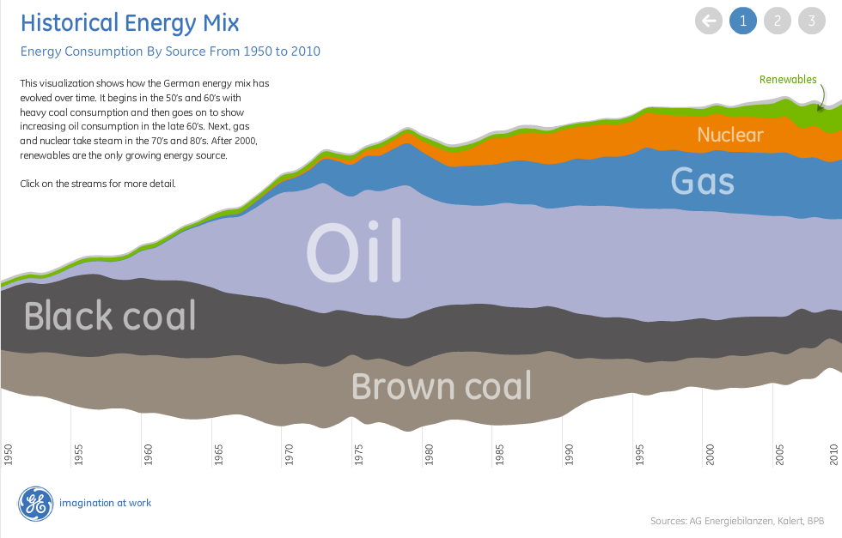
Energy Consumption By Source from 1950-2010
http://www.theusrus.de/blog/page/4/

Slide 4
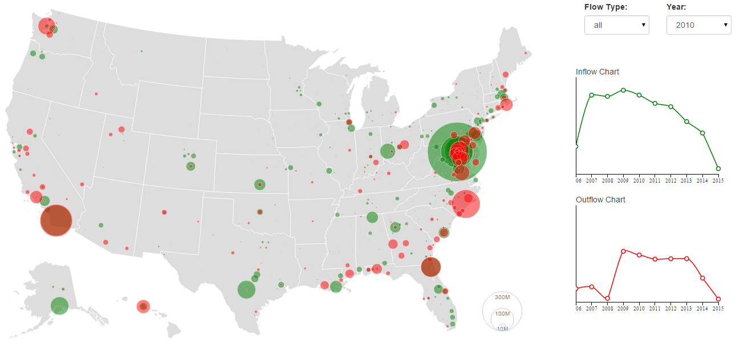
Web Science and Digital Libraries Research Group
http://ws-dl.blogspot.com/

Slide 5
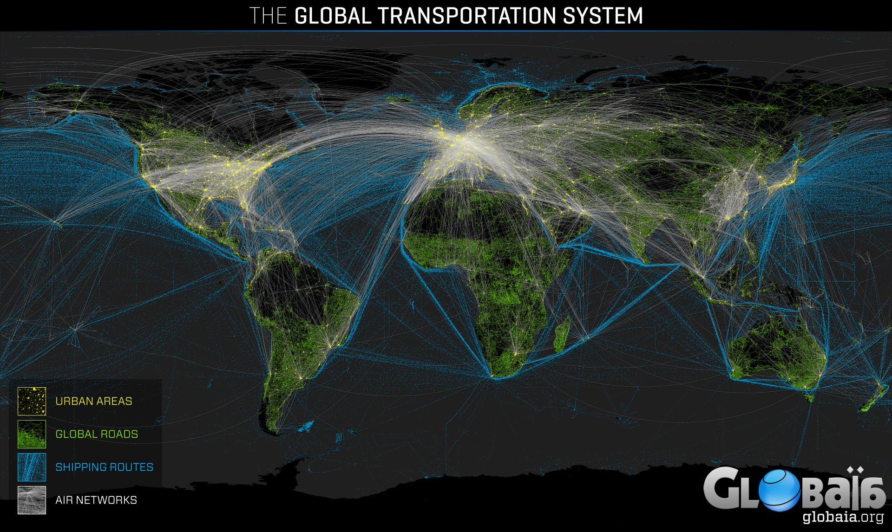
The Global Transportation System
http://globaia.org/portfolio/cartography-of-the-anthropocene/

Slide 6
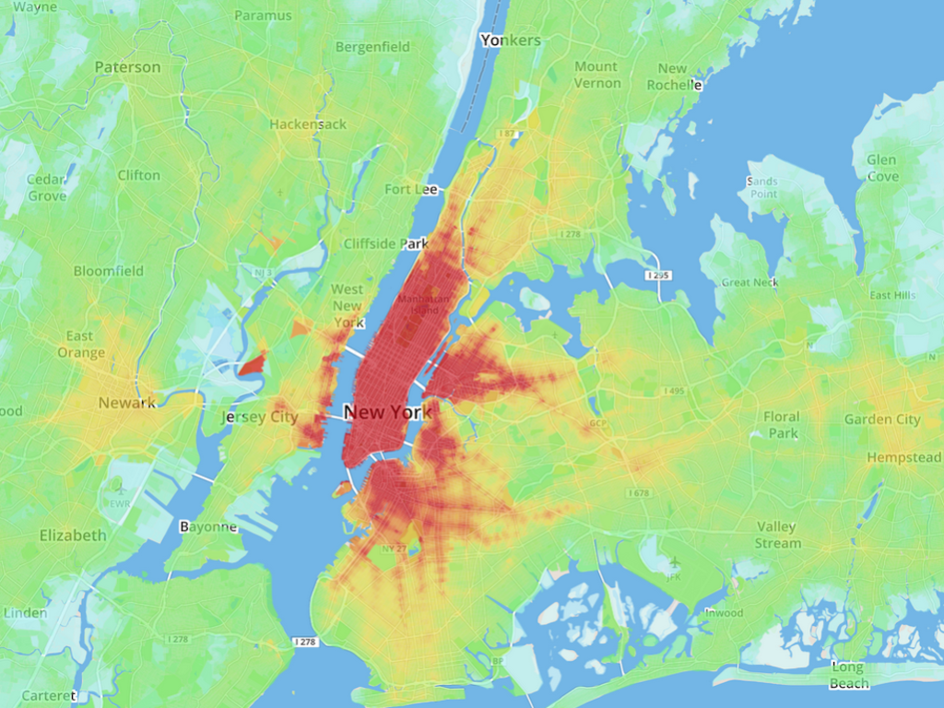
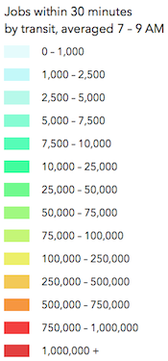
America’s 10 Best Cities for Commuting on Public Transit
http://www.wired.com/2014/10/americas-10-best-cities-commuting-public-transit/

Slide 7
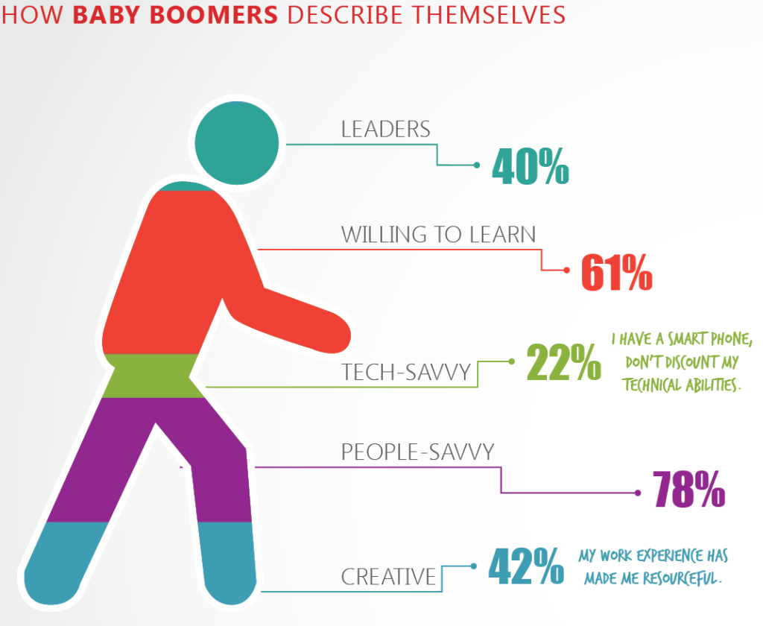
Bad math
http://wpengine.com/blog/ugly-side-data-visualization/

Slide 8
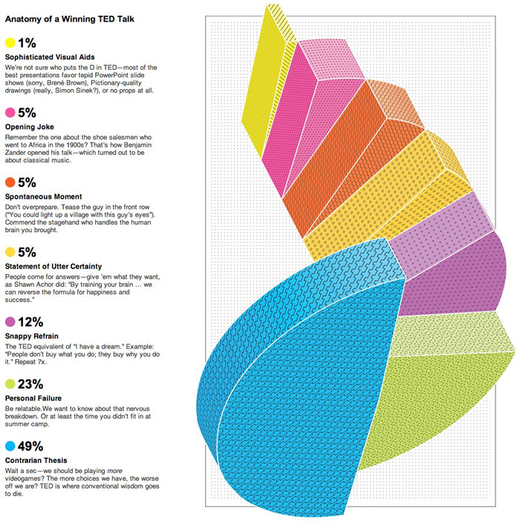
Confusing graph
http://cdn.wpengine.com/wp-content/uploads/2014/03/Anatomy-of-a-winning-TED-Talk.jpg

Slide 9
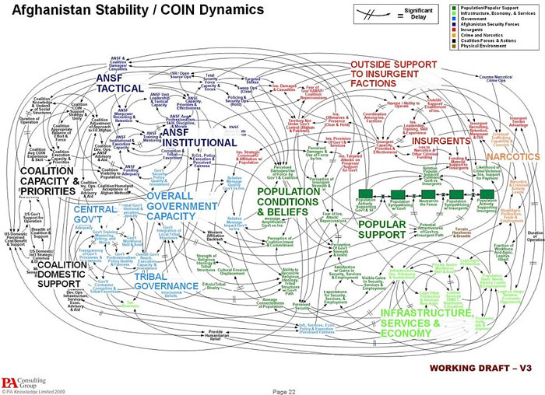
Too much information
http://cdn.wpengine.com/wp-content/uploads/2014/03/Afghanistan-Stability-COIN-Dynamics.jpg

Slide 10
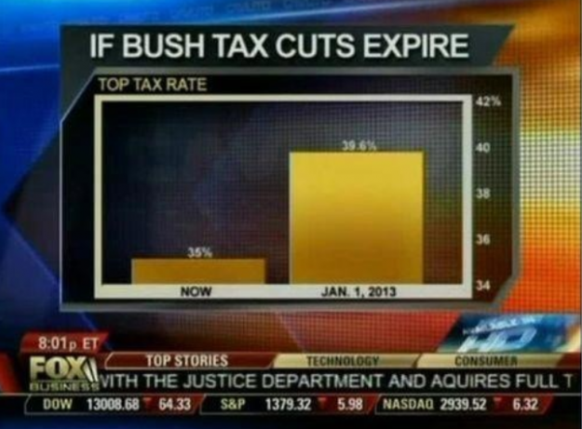

Slide 11
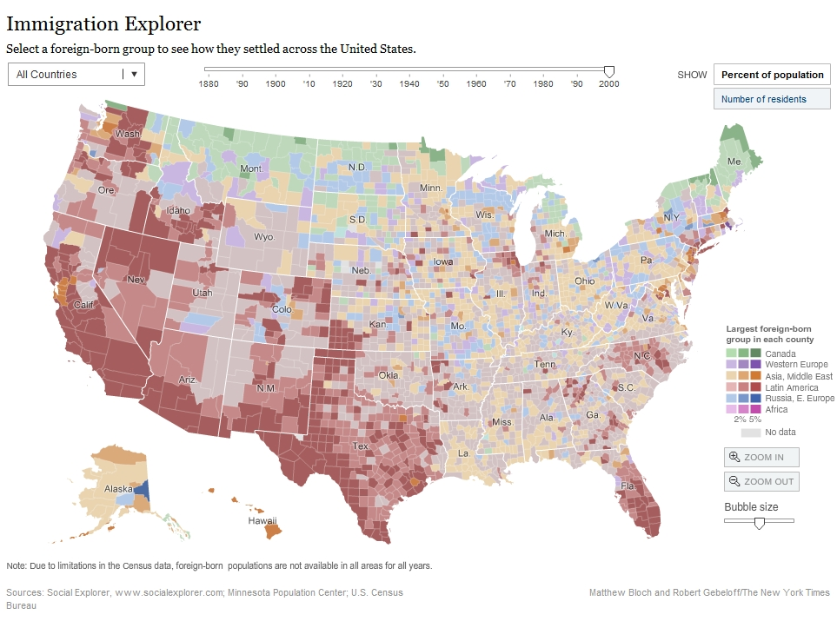
Examples – Geo data mapping
Demo

Slide 12
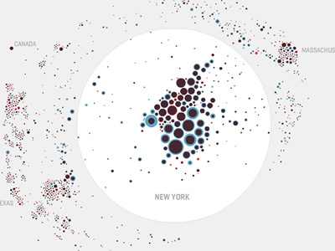
Examples – Map your moves
where New Yorkers move (10 years data)
distorted map circle = moves for one zip code
red – out blue – in
overlaid
Demo

Slide 13
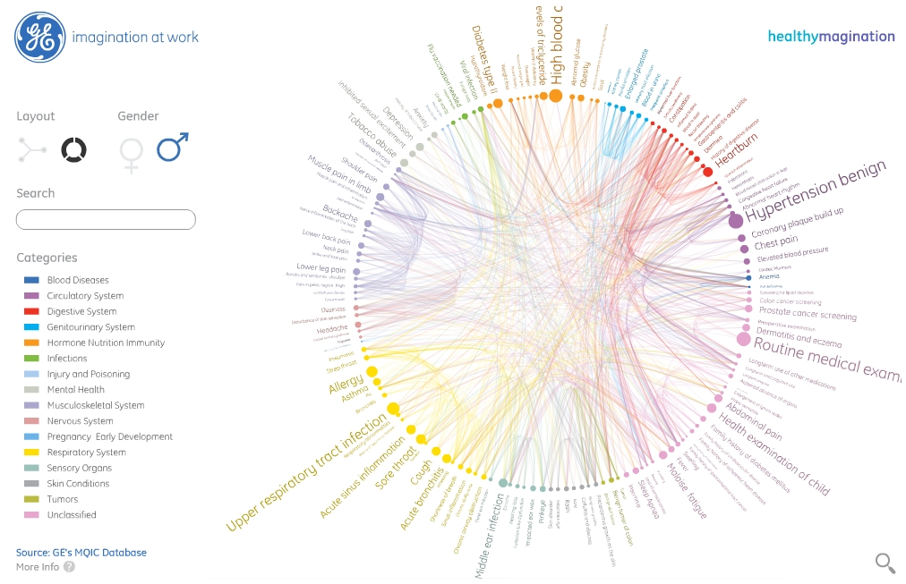
Example – Circle Chart
Demo

Slide 14
What is Visualization?
“the communication of information using graphical representations” --- Ward et al.
“Transformation of the symbolic into the geometric” --- McCormick et al.
“…finding the artificial memory that best supports our natural means of perception” --- Bertin

Slide 15
What is Visualization?
Information visualization can be defined as the use of interactive visual representations of abstract data
Information visualization provides compact graphical presentations and user interfaces for interactively manipulating large numbers of items

Slide 16
Why visualize?
Vision is “highest bandwidth” sense
Fast and parallel
Pre-attentive processing
Eye trained for pattern recognition
Scanning
Recognizing
Remembering images

Slide 17
Types of Symbolic Displays (Kosslyn 89)
Graphs
At least two scales required; values associated in symmetric “paired” relation
Examples: Scatter-plot, bar-chart
Charts
Discrete relations among discrete entities
Structure relates entities to one another
Examples: family tree, flow chart, network diagram

Slide 18
Types of Symbolic Displays (cont’d)
Maps
Internal relations determined (in part) by the spatial relations of what is pictured
Diagrams
Schematic pictures of objects or entities
Parts are symbolic (unlike photographs)

Slide 19
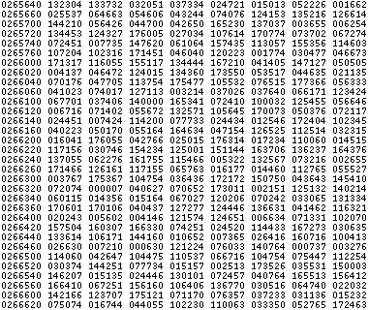
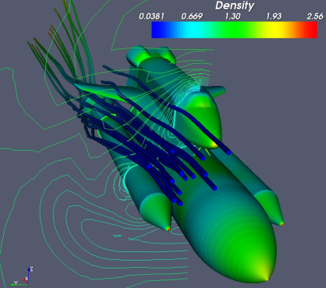
“Sci Viz” vs. “Info Viz”
Visualization: converting raw data to a form that is viewable and understandable to humans.
Scientific visualization: specifically concerned with data that has a well-defined representation in 2D or 3D space (e.g., from simulation mesh or scanner).
*Adapted from The ParaView Tutorial, Moreland

Slide 20
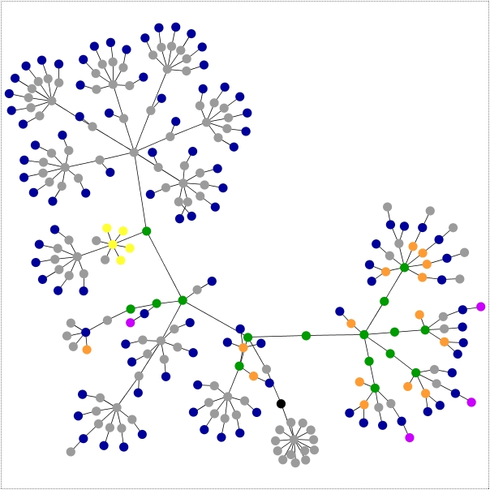
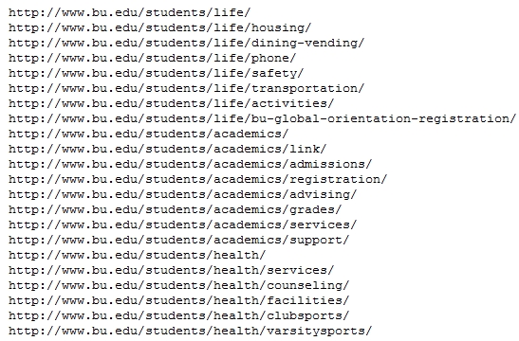
Information Visualization
Information visualization: concerned with data that does not have a well-defined representation in 2D or 3D space (i.e., “abstract data”).

Slide 21
Visualization Components
Color
Size
Texture
Proximity
Annotation
Interactivity
Selection / Filtering
Zoom
Animation

Slide 22
GGPLOT2
ggplot2 divides plot into three different fundamental parts: Plot = data + Aesthetics + Geometry.
The principal components of every plot can be defined as follow:
Data -- is a data frame
Aesthetics -- is used to indicate x and y variables. It can also be used to control the color, the size or the shape of points, the height of bars, etc…
Geometry -- defines the type of graphics (histogram, box plot, line plot, density plot, dot plot, ….)
GG stands for “Grammer of Graphics”

Slide 23
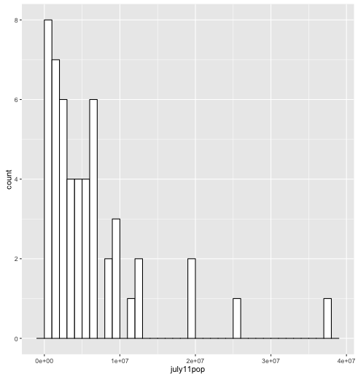
GGPLOT2 – Histogram
ggplot(dfStates, aes(x=july11pop)) +
geom_histogram(binwidth=1000000, color="black", fill="white")

Slide 24
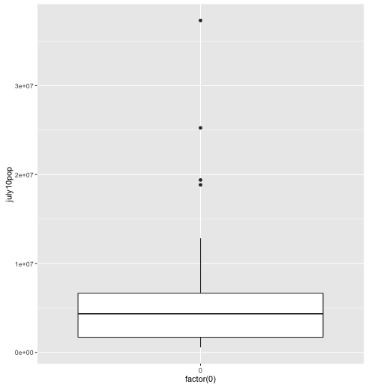
GGPLOT2 – Boxplot
ggplot(dfStates,aes(x=factor(0),july10pop)) +
geom_boxplot()

Slide 25
GGPLOT2 – Timed Task
dayOfWeekFactor time week
1 mon 4.0 1
2 tues 4.5 1
3 wed 3.5 1
4 thurs 5.0 1
5 fri 4.0 1
6 sat 4.2 1
7 mon 4.5 2
8 tues 5.0 2
9 wed 3.8 2
10 thurs 5.2 2
11 fri 4.6 2
12 sat 4.3 2

Slide 26
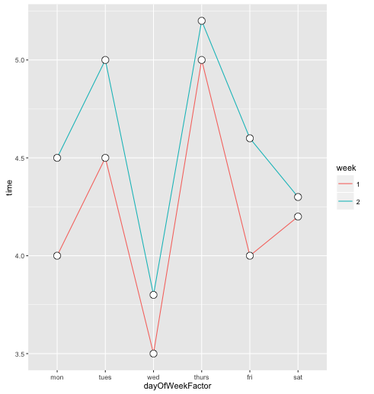
GGPLOT2 – Lines
g <- ggplot(travel.df, aes(x = dayOfWeekFactor, group=week, color=week)) + geom_line(aes(y = time))
g <- g + geom_point(y=time, colour="black", size=4, shape=21, fill="white”)
g <- g + ylab("time to NYC (in hours)") + ggtitle("compare weekly times")
g

Slide 27
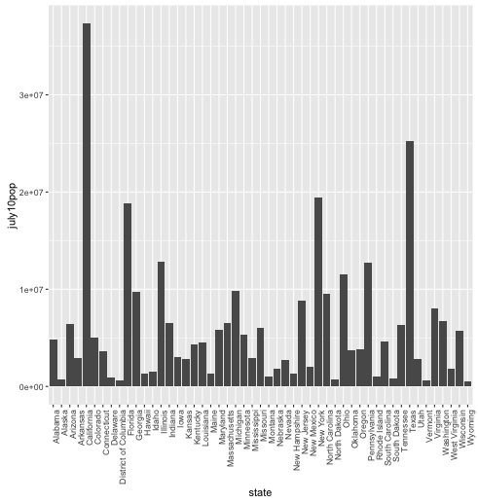
GGPLOT2 – Bars
g <- ggplot(dfStates, aes(x=state, y=july10pop)) + geom_bar(stat="identity")
g <- g + theme(axis.text.x = element_text(angle = 90, hjust = 1))
g

Slide 28
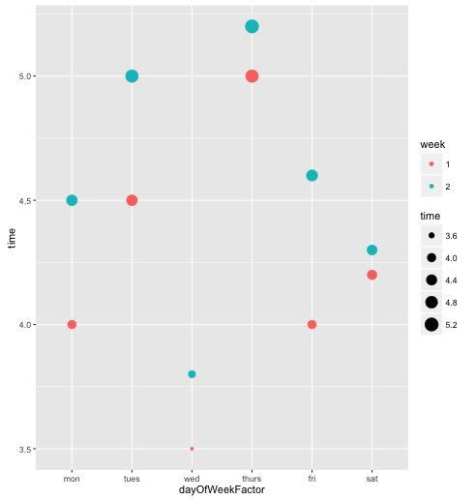
GGPLOT2 – Scatter
ggplot(travel.df, aes(x=dayOfWeekFactor, y=time)) + geom_point(aes(size = time, color=week))

Slide 29
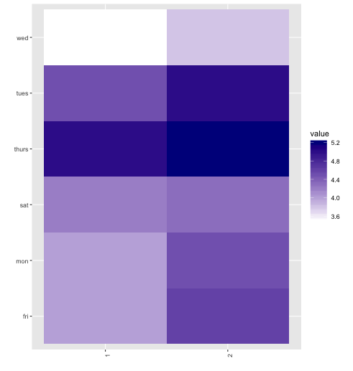
GGPLOT2 – Heatmap
melted.df <- melt(travel.df,id= c("week","dayOfWeekFactor"))
p <- ggplot(melted.df, aes(x=week, y=dayOfWeek))
g <- p + geom_tile(aes(fill=value)) + scale_fill_gradient(low="white", high="darkblue") + xlab("") + ylab("")
g + theme(axis.text.x = element_text(angle = 90, hjust = 1))
Notes:
The melt function takes data in wide format and stacks a set of columns into a single column of data.
To make use of the function we need to specify a data frame, the id variables (which will be left at their settings) and the measured variables (columns of data) to be stacked.
The default assumption on measured variables is that it is all columns that are not specified as id variables.

Slide 30
10 Principles in Visualization
C. Kelleher and T. Wagener (2011)
Environmental Modelling & Software: 1-6

Slide 31
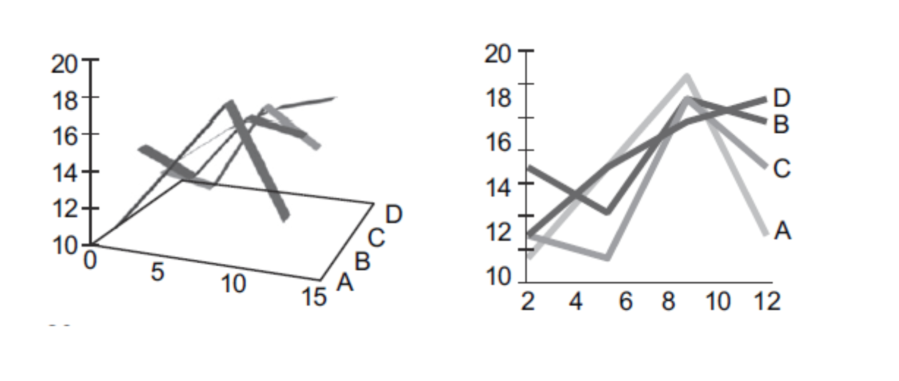
1. Simplicity
Create the simplest graph that conveys the information you want to convey (Tufte)

Slide 32
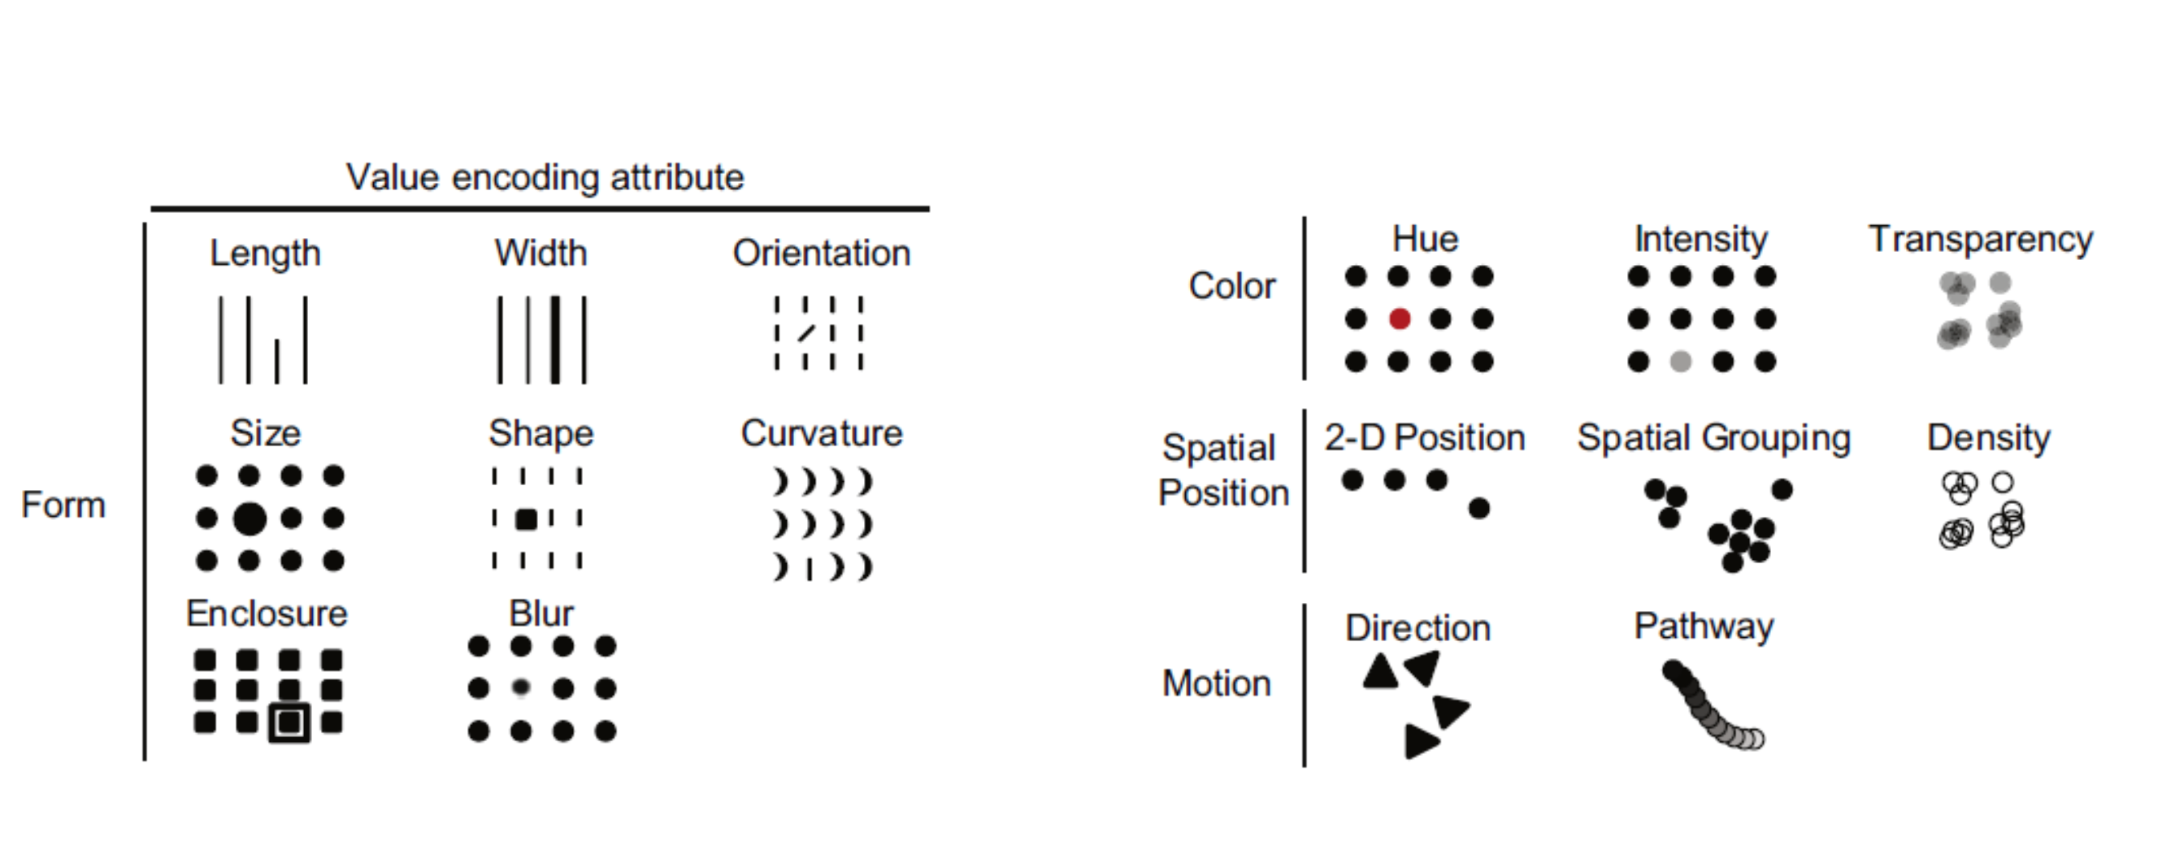
2. Encoding
Consider the type of encoding object and attribute used to create a lot (Chambers et al., 1983 [137-140]; Cleveland & McGill, 1984)
Notes:
e.g. length and position vs. hue/tint

Slide 33
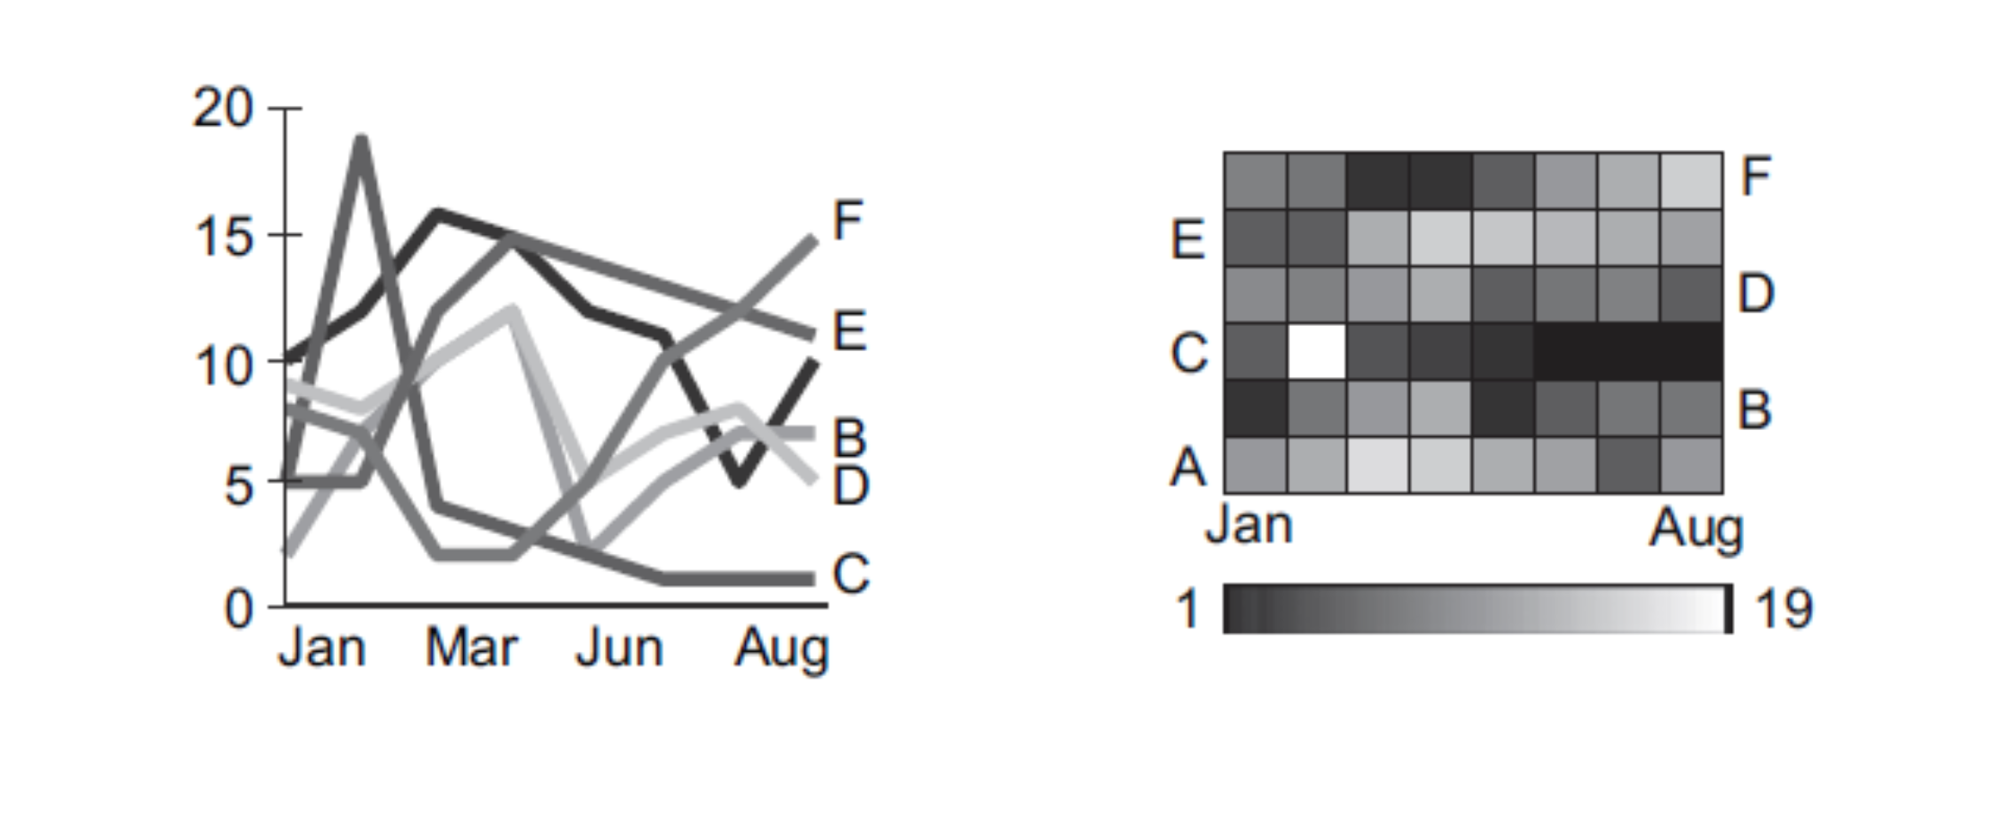
3. Patterns vs. Details
Focus on visualizing patterns or on visualizing details (Few, 2004a; Kosslyn and Chabris, 1992)
Notes:
e.g. Heatmaps vs. Bar graphs

Slide 34
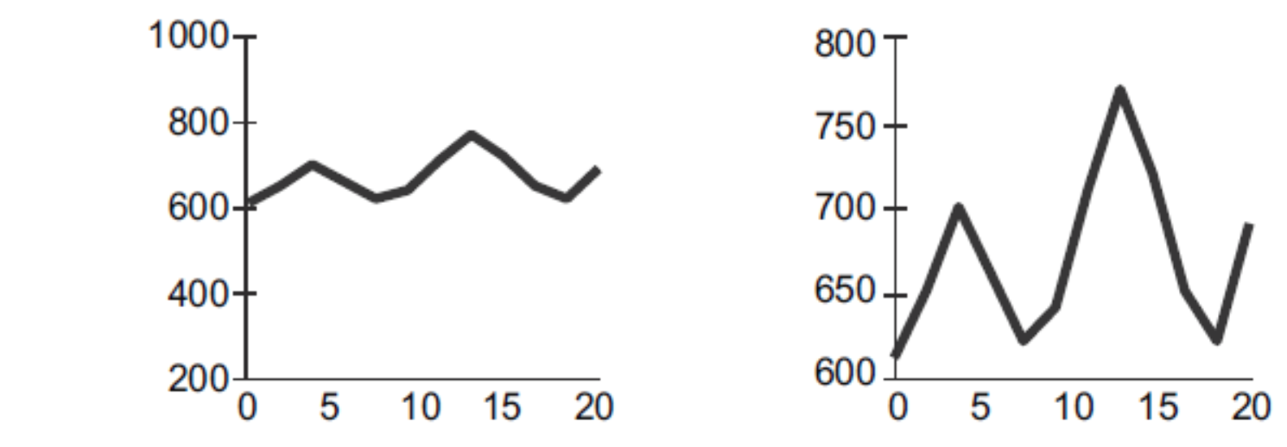
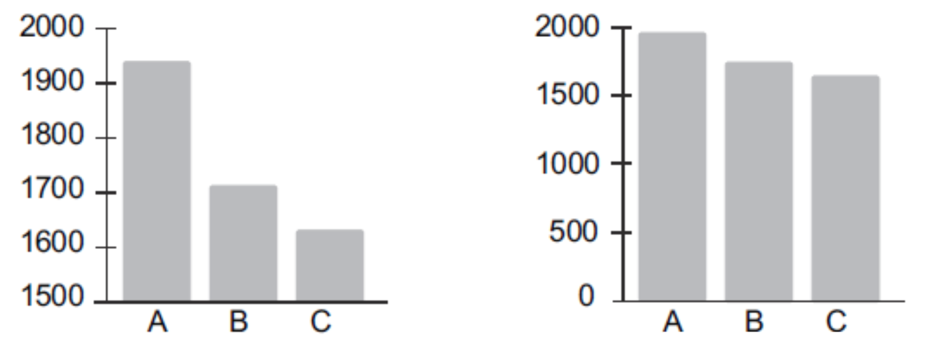
4. Ranges
Select meaningful axis ranges (Robbins,2005[239- 241; 285]; Tufte, 2006 [p. 60]; Strange, 2007 [p. 89])

Slide 35
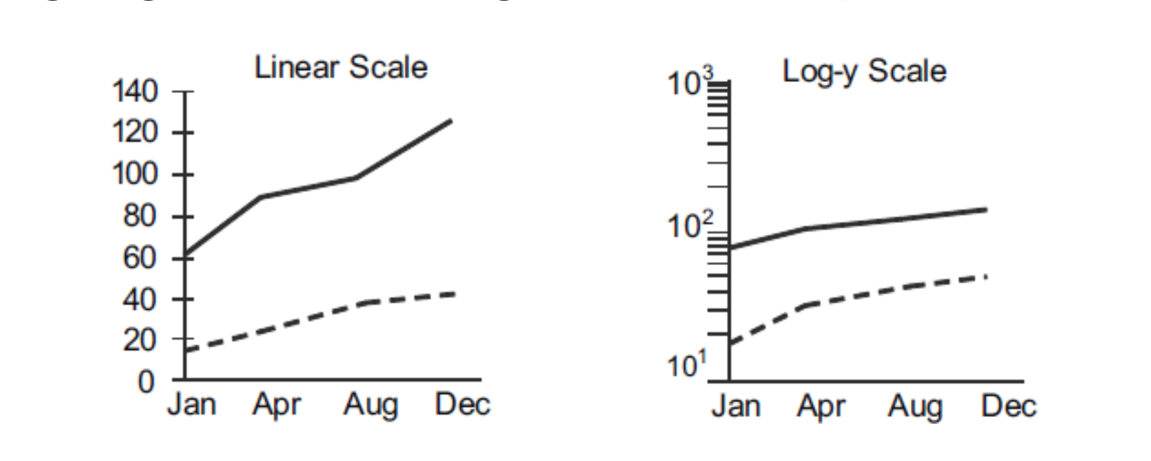
5. Transformations
Data transformations and carefully chosen aspect ratios can be used to emphasize rates of change for time-series data (Cleveland, 1994 [p. 66, 95, 103])
Notes:
e.g. Log shows % change, choice of aspect ratio

Slide 36
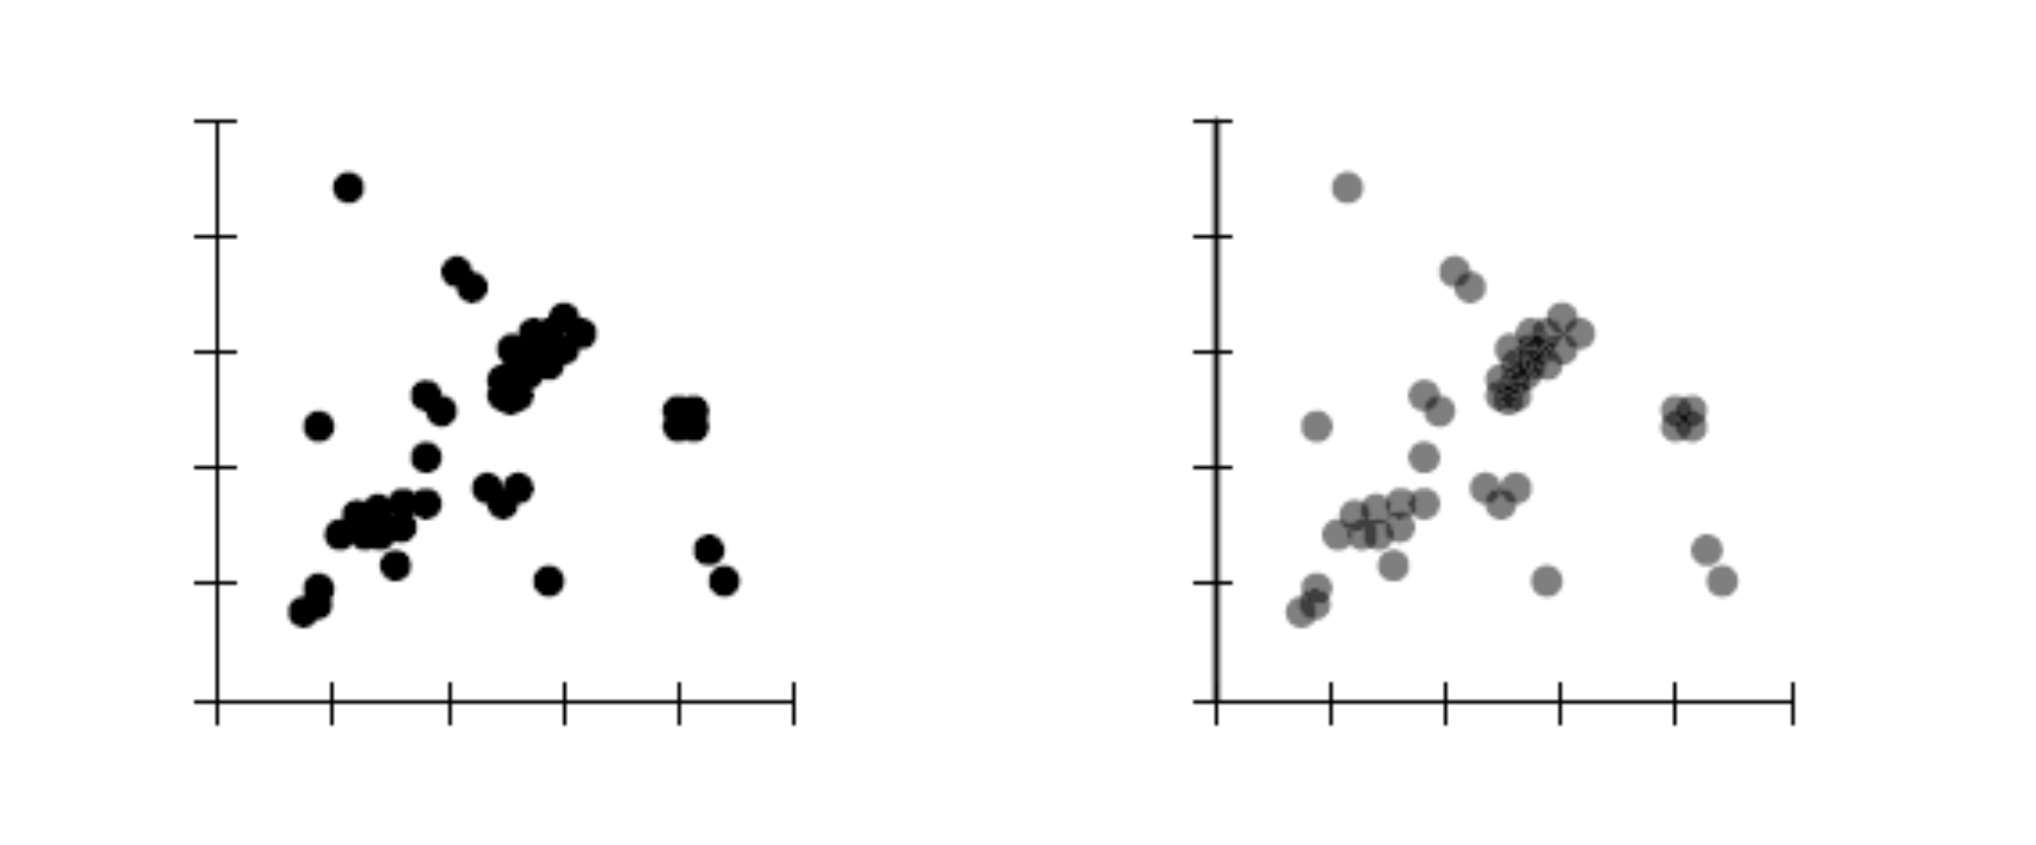
6. Show density
Plot overlapping points in a way that density difference become apparent (Few, 2009 [p. 121];Cleveland, 1994 [p. 159])

Slide 37
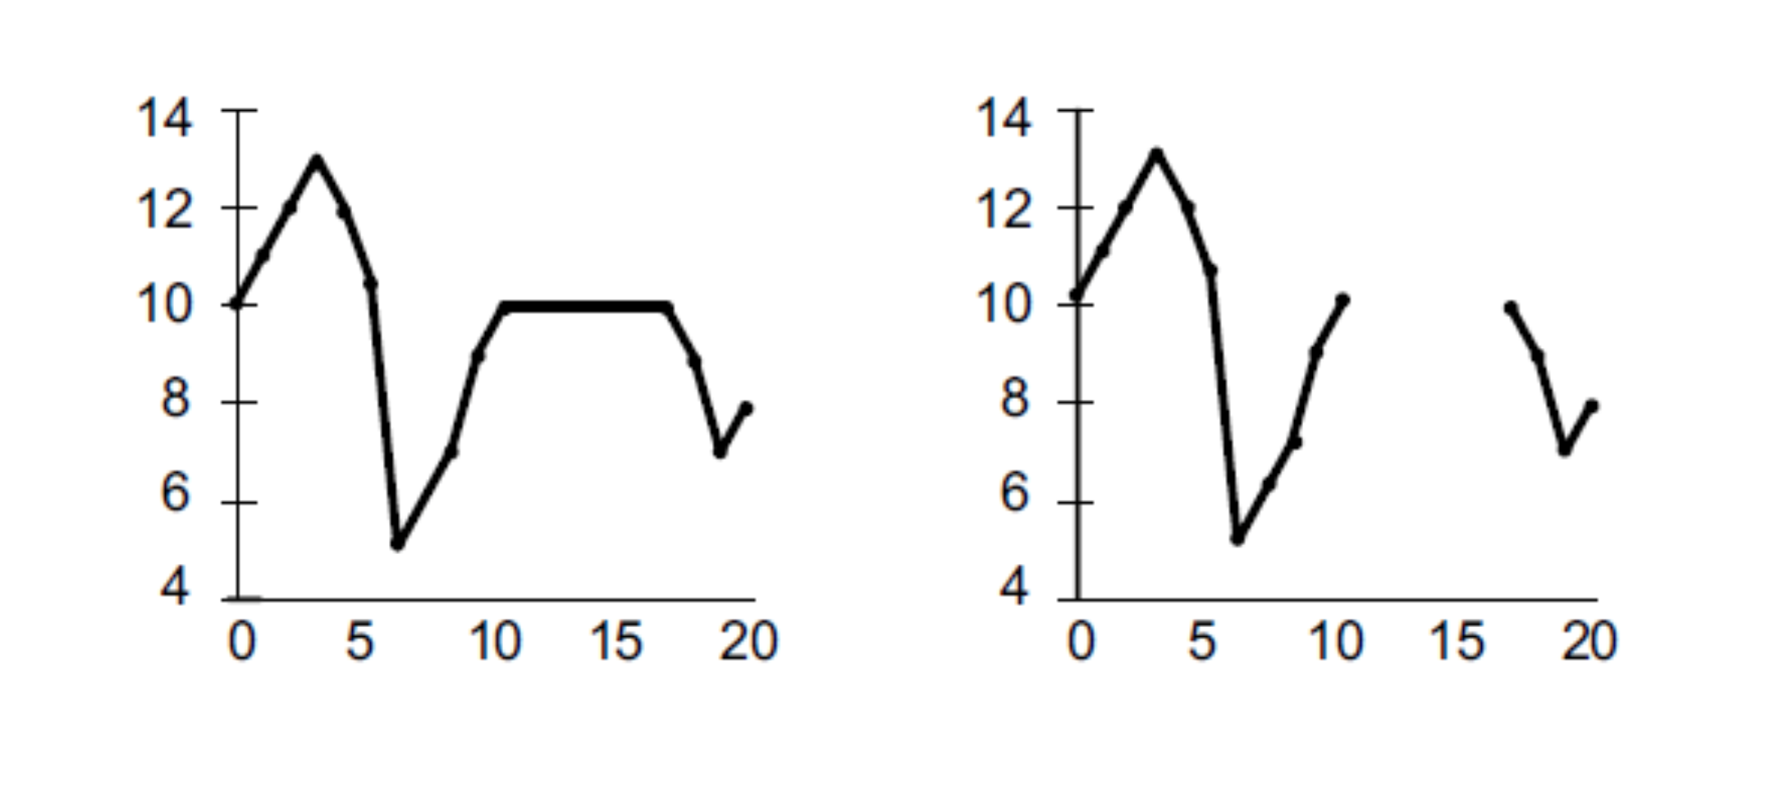
7. Connections
Use lines when connecting sequential data in time-series plots (Strange, 2007 [p. 150])

Slide 38
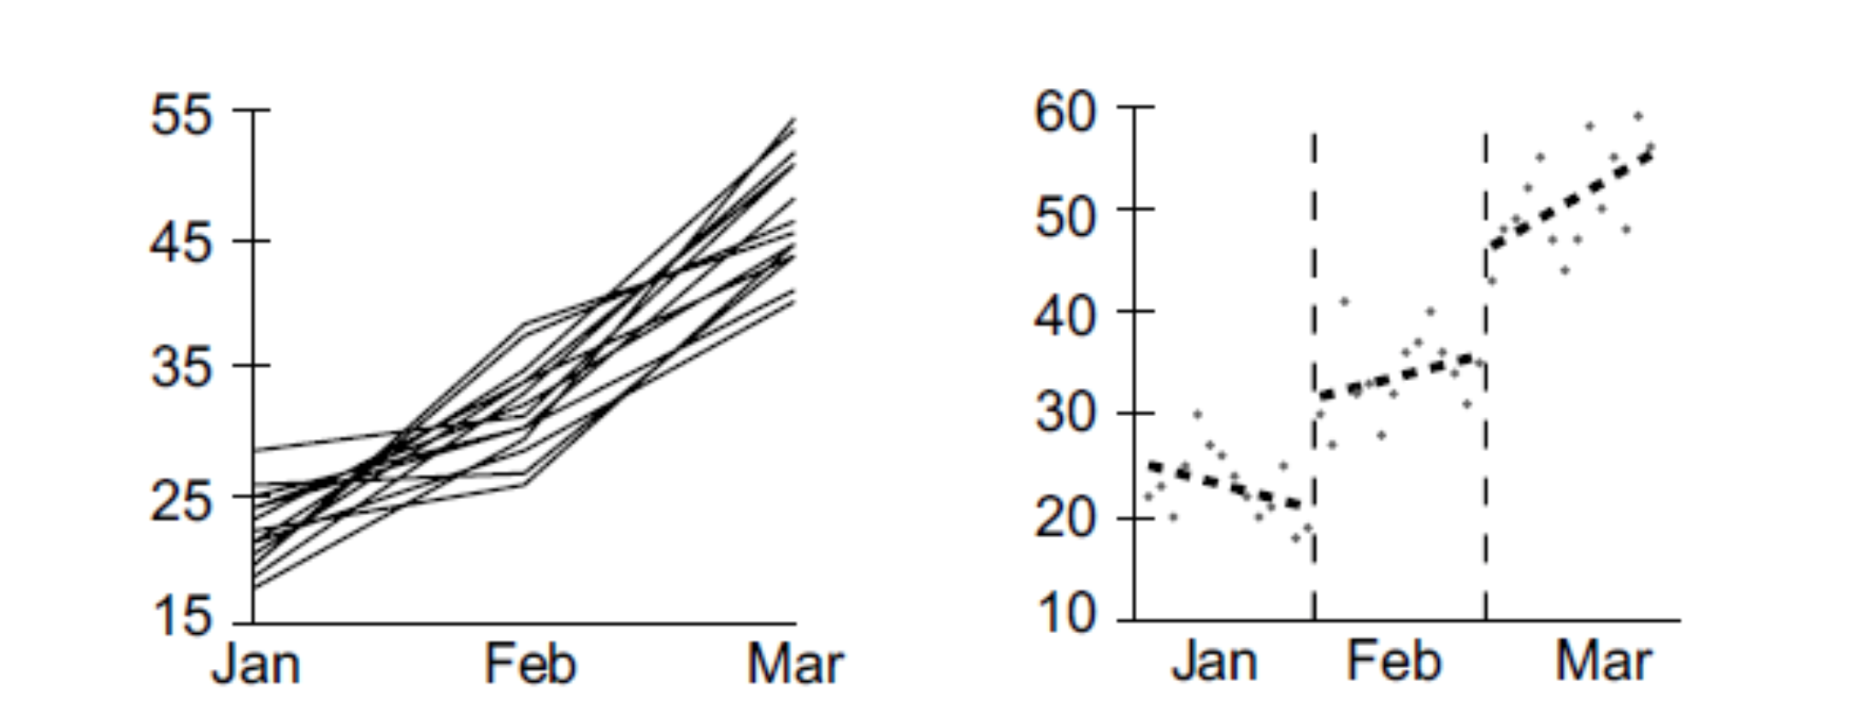
8. Aggregates
Aggregate larger datasets in meaningful ways (Cleveland and Devlin, 1980; Chambers et al., 1983 [pp. 21-24]; Cleveland, 1994 [187])

Slide 39
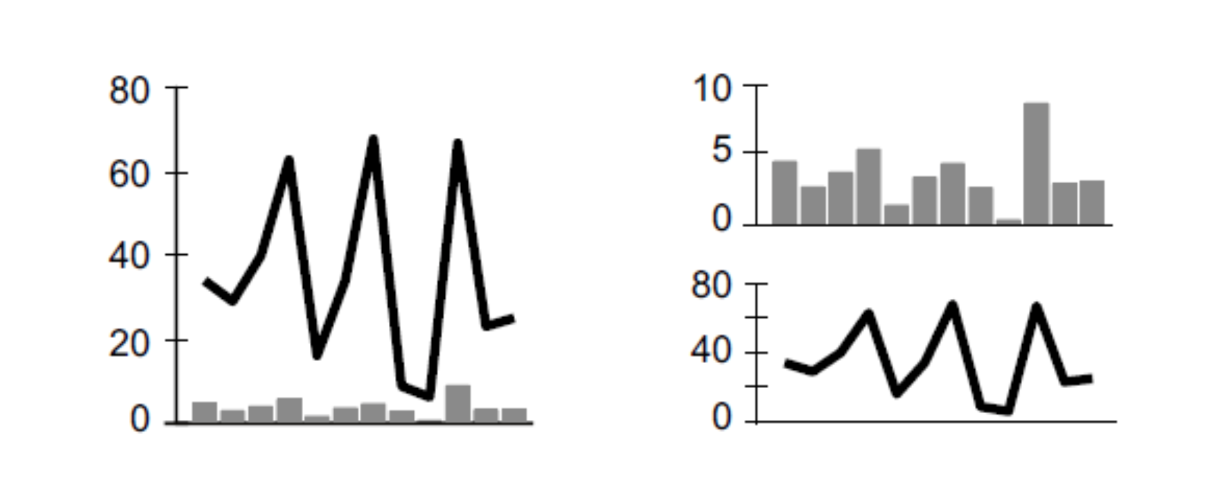
9. Comparison
Keep axis ranges as similar as possible to compare variables (Cleveland, 1994, [pp.86e87]; Few, 2009 [p. 180])

Slide 40
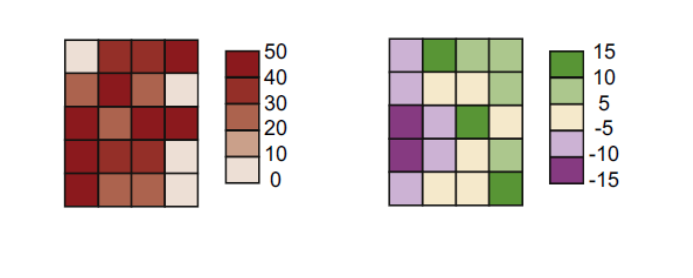
10. Colors
Select an appropriate color scheme based on the type of data (Brewer, 1994; Harrower and Brewer, 2003)
Notes:
Use light/dark tint, not hue

